Slide 1
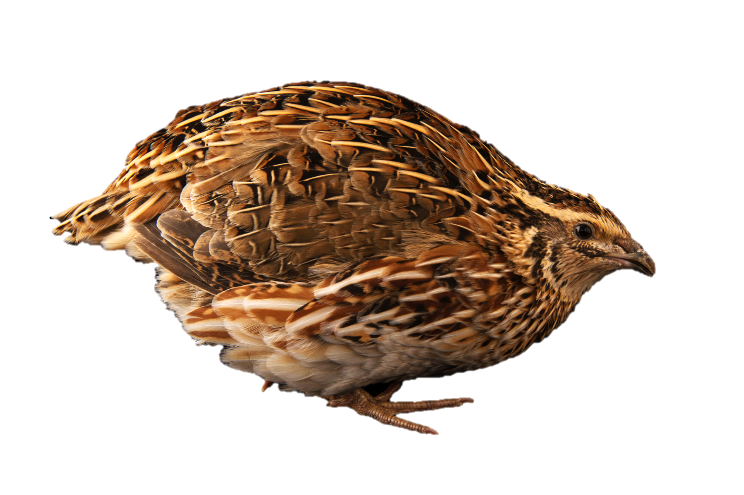

The effects of 17⍺-Ethinylestradiol on hepatic transcriptome of early-life stage and adult Japanese quail
Yeon Seon Jeon, Jin Kweon, Qian Li, Janice Ou

Slide 2
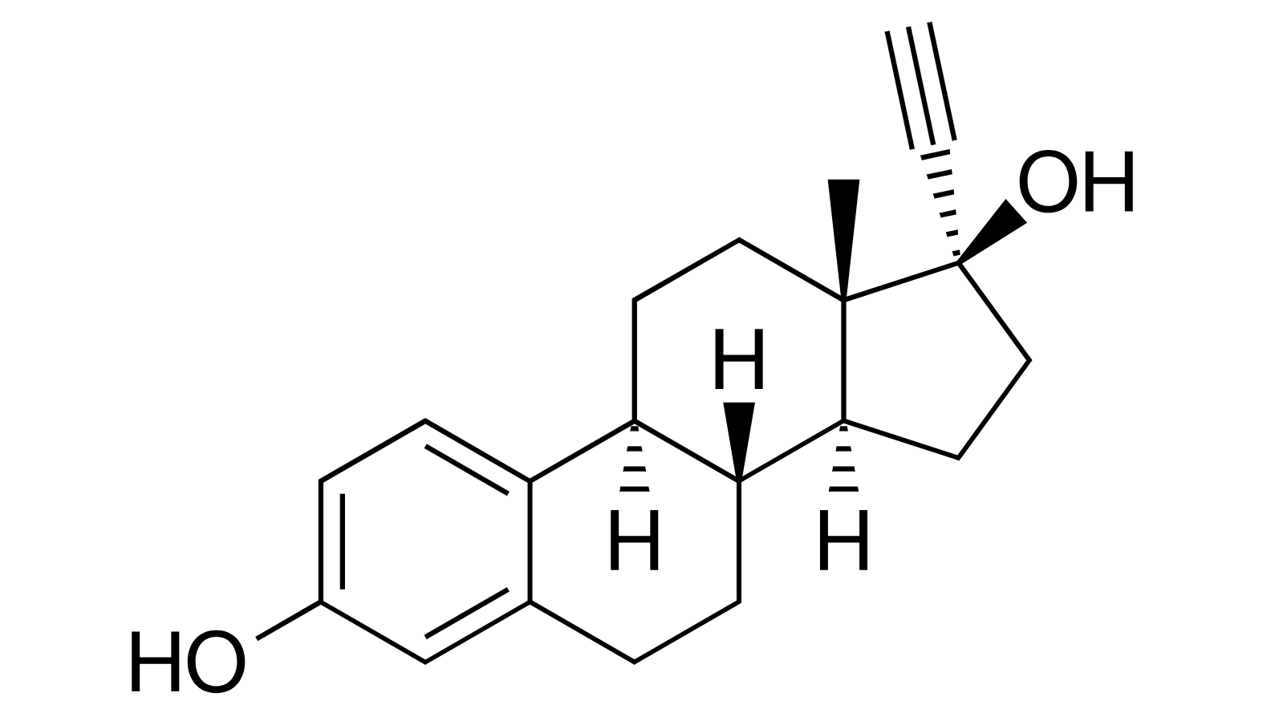


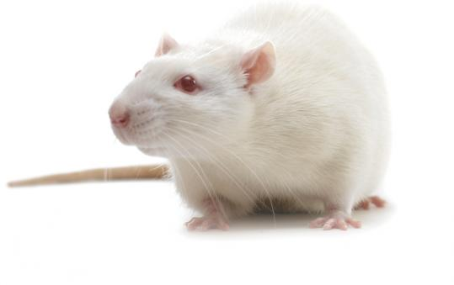
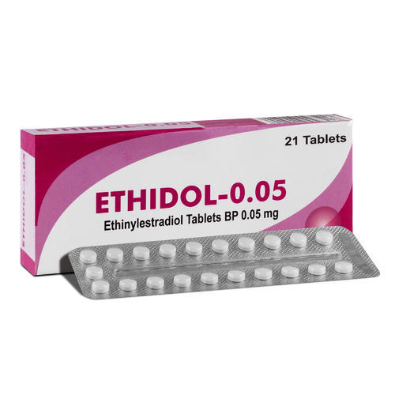
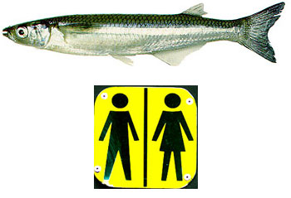
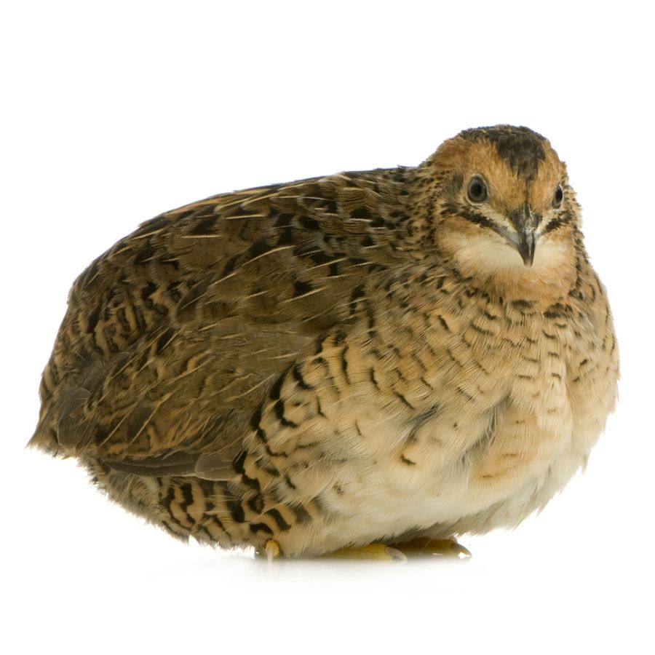
What impact does 17⍺-ethinylestradiol (EE2) has on wildlifes (birds) ?
Background
Questions
Methods
Results
Discussion
Conclusion
• Released into environment
• Open source to animals
EE2
• a bio-active estrogen
• widely used in animal
husbandry and fishery
• in birth control pills for human
VS
(Chen, 2017; Pokharel, 2018; Vosges, 2008)
https://www.watertechonline.com/montreal-plans-to-dump-sewage-into-st-lawrence-river/

Slide 3
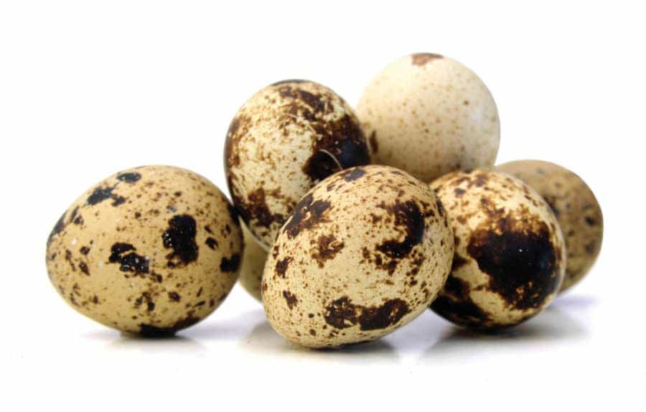



Using RNA-seq to test the impact of EE2 to Japanese quail adult stage vs Early life stage (ELS)
Background
Questions
Methods
Results
Discussion
Conclusion
vs
Japanese quail Adult
Early life stage (ELS)
?
Information
vs
Traditional toxicity test
Genotoxicity test
Information
Mohammed, 2013

Slide 4



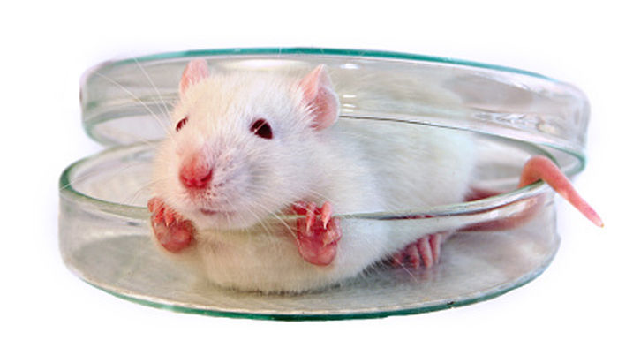
Traditional Animal toxicity testing
Background
Question
Method
> 84,000 chemicals to test
Costly
Newly registered chemicals
Mixtures of substances
Non-model species
🡪 Alternative approaches necessary!
3-4 years
$1-20M
>1,000 animals
(per chemical)
23,000 chemicals (CA CMP)
$1-20M; >1,000 animals; 3-4 years per chemical, 84,000 chemicals (US TSCA)
€9.5B; 54M vertebrate animals with 107,000 chemicals (EU REACH)
Garcia-Reyero, N., & Murphy, C. A. (Eds.). (2018). A Systems Biology Approach to Advancing Adverse Outcome Pathways for Risk Assessment. Springer.

Slide 5
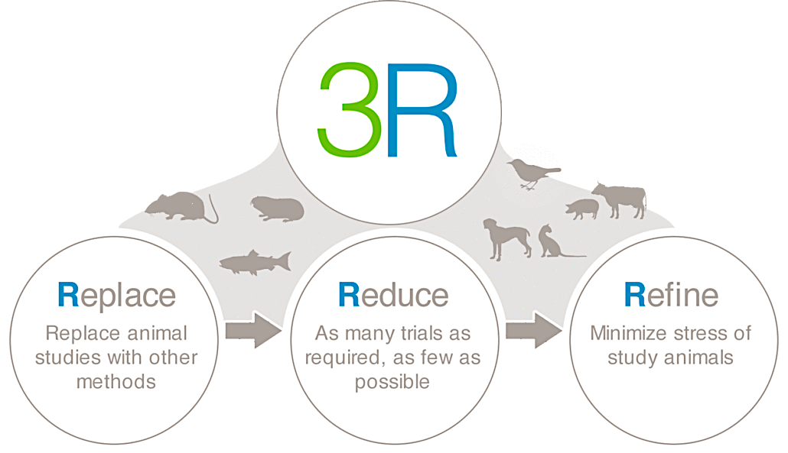
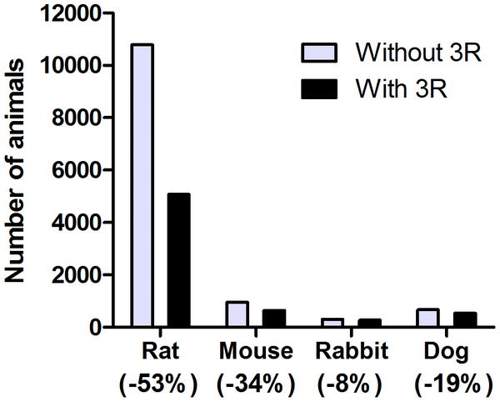
Alternative approaches
Background
Question
Method
not defined
as protected
animal
fewer animals
less suffering
with humane
endpoint
© Bayer and Animal Studies
in vitro tests
possible
big data with fewer animals
higher
sensitivity
Toxicogenomics
Early life stage
Törnqvist, E., Annas, A., Granath, B., Jalkesten, E., Cotgreave, I., & Öberg, M. (2014). Strategic focus on 3R principles reveals major reductions in the use of animals in pharmaceutical toxicity testing. PloS one, 9(7), e101638.
Figure 3. Estimated reduction in number of animals used in toxicity studies at Safety Assessment Research Unit.

Slide 6
Research questions
Background
Questions
Methods
Results
Discussion
Conclusion
What is the transcriptomic responses of ELS Japanese quail to EE2?
2. What is the transcriptomic responses of adult Japanese quail to EE2?
Hypothesis: ELS would be more susceptible to EE2 than adult
Expected Outcome: ELS would have more differentially expressed genes (DEGs), higher degree of dysregulation, and more dysregulated pathways than adult.

Slide 7
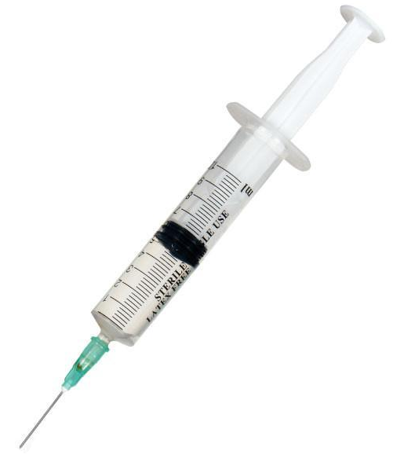
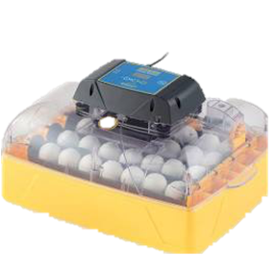
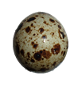
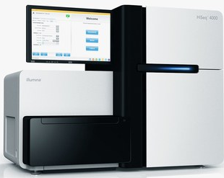
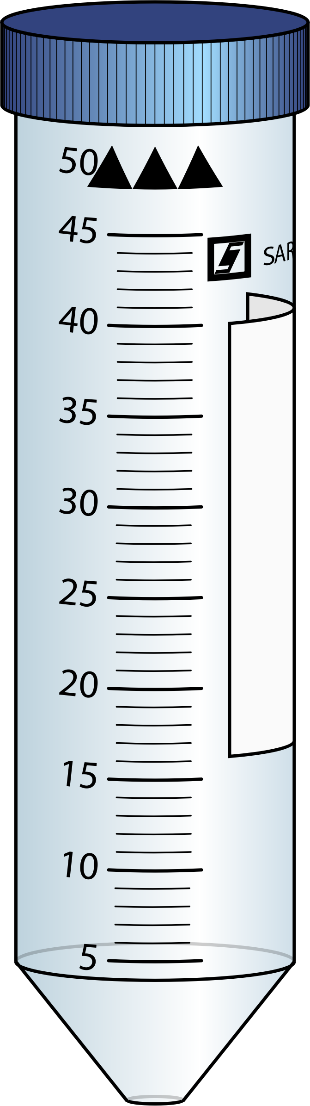
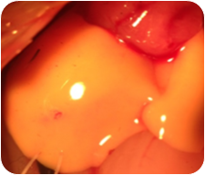
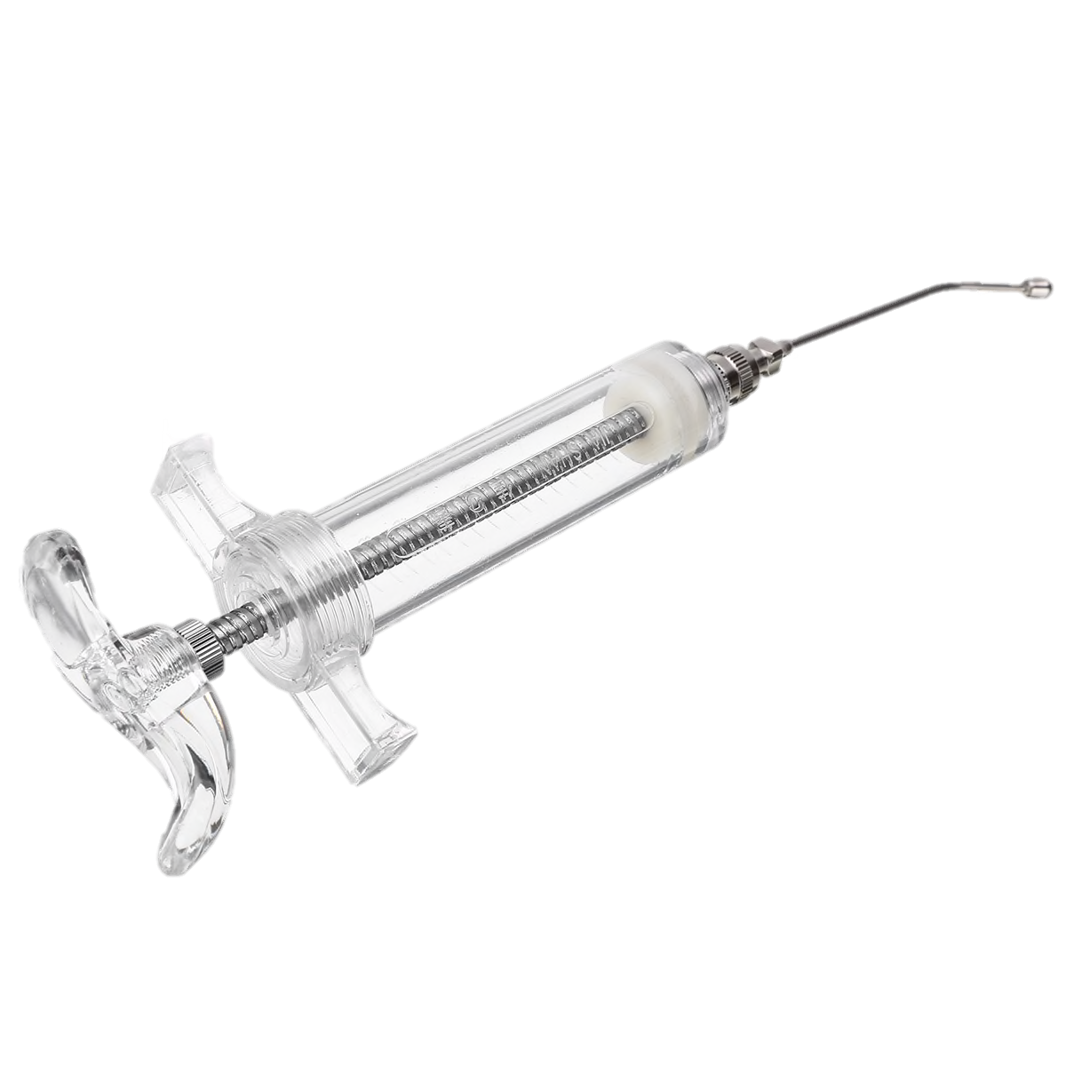

Data collection
Background
Questions
Methods
Results
Discussion
Conclusion
Exposure
Incubation
Sampling
RNA-seq
EE2
9 days
ELS
At 37°C and 60% humidity
Genome Quebec
4 days
Liver
RNA→ cDNA
Control (Con)
Medium dose (Med)
High dose
(5 replicates/dose)
Adult

Slide 8
Data analysis flow
Background
Questions
Methods
Results
Discussion
Conclusion
Pre-processing
to transcript counts
Kallisto
reference: all others against common reference

Slide 9
Data analysis flow
Background
Questions
Methods
Results
Discussion
Conclusion
Pre-processing
to transcript counts
Kallisto
1. Duplicated rows removing
(sum values)
2. Missing value checking
3. Low variance filtering
(based on IQR)
4. Low count filtering
(based on mean abundance)
5. Trimmed mean of M-values
(TMM) normalization
Filtration and
normalization
ELS Adult

Slide 10
Data analysis flow
Background
Questions
Methods
Results
Discussion
Conclusion
Pre-processing
to transcript counts
Kallisto
1. Duplicated rows removing
(sum values)
2. Missing value checking
3. Low variance filtering
(based on IQR)
4. Low count filtering
(based on mean abundance)
5. Trimmed mean of M-values
(TMM) normalization
Filtration and
normalization
Differential expression analysis
(DEA) EdgeR
Annotation filter
ELS:13342 Adult:12415
reference: all others against common reference
ELS Adult

Slide 11
Data analysis flow
Background
Questions
Methods
Results
Discussion
Conclusion
Pre-processing
to transcript counts
Kallisto
1. Duplicated rows removing
(sum values)
2. Missing value checking
3. Low variance filtering
(based on IQR)
4. Low count filtering
(based on mean abundance)
5. Trimmed mean of M-values
(TMM) normalization
Filtration and
normalization
Differential expression analysis
(DEA) EdgeR
Enrichment analysis
(Networkanalyst.ca)
Additional analyses to compare ELS and adult
Annotation filter
ELS:13342 Adult:12415
reference: all others against common reference
ELS Adult

Slide 12
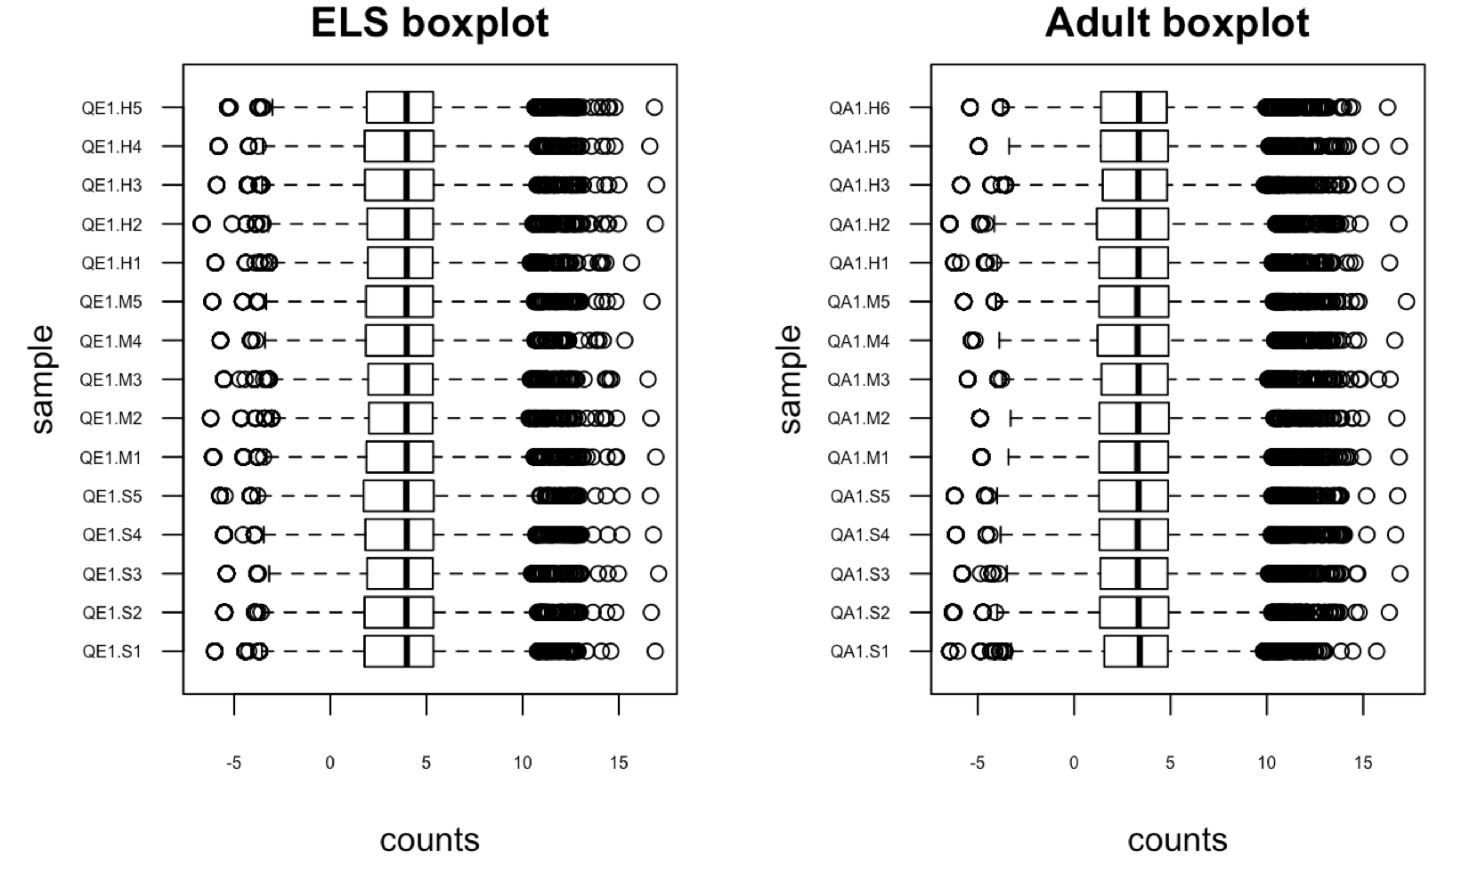
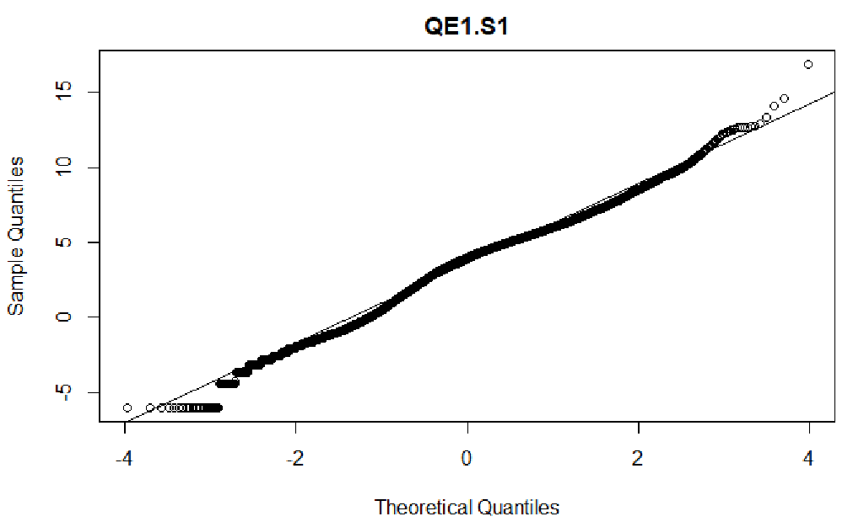
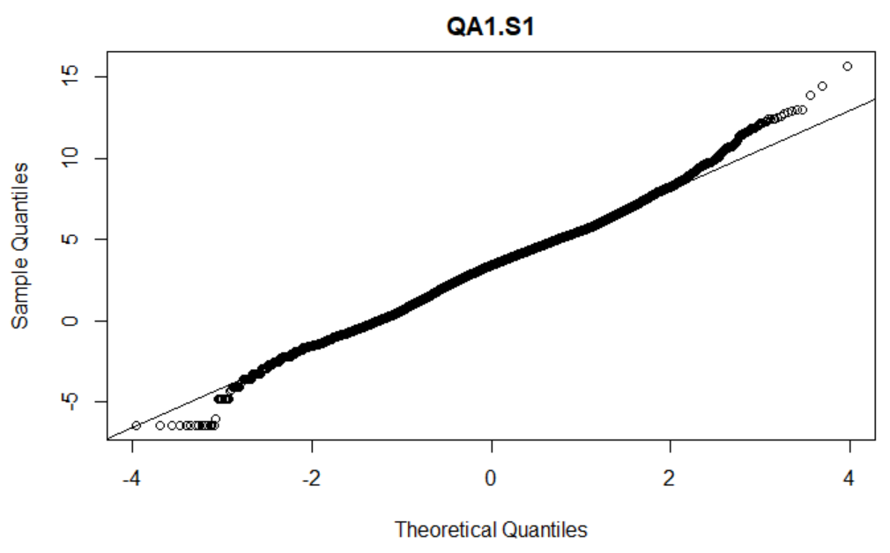
Sanity check
Questions
Questions
Methods
Conclusion
Background
Methods
Background
Conclusion
Results
Discussion
Results
ELS
Adult

Slide 13
Sanity check
Questions
Questions
Methods
Conclusion
Background
Methods
Background
Conclusion
Results
Discussion
Results
a.
b.
ELS
Adult

Slide 14
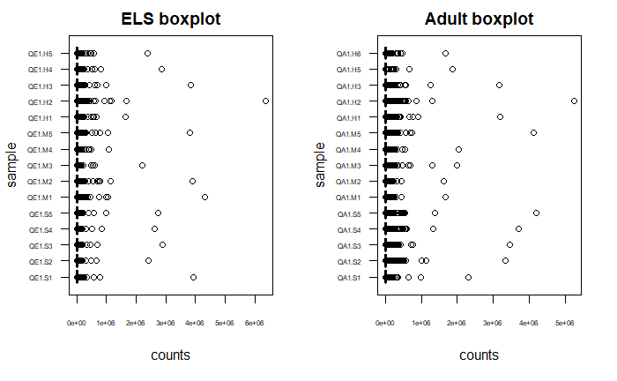
Sanity check
Questions
Questions
Methods
Conclusion
Background
Methods
Background
Conclusion
Results
Discussion
Results
a.
ELS
Adult

Slide 15
Background
Questions
Methods
Results
Discussion
Conclusion
Question 1:
What is the transcriptomic responses of ELS Japanese quail to EE2 ?

Slide 16
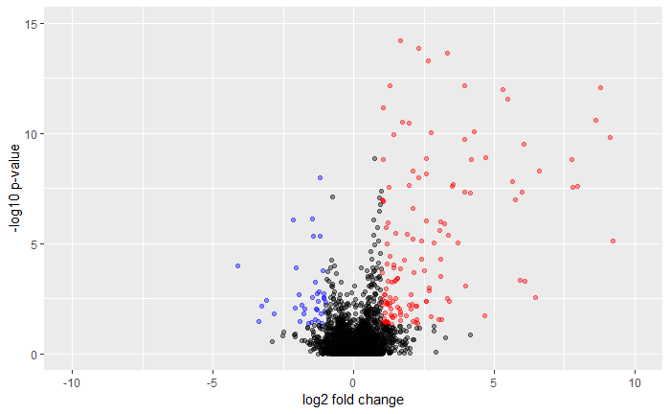
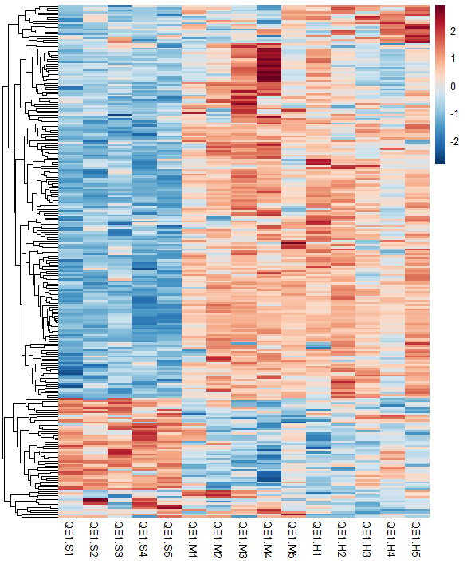

Answer1: differentially expressed gene (DEGs) numbers in ELS
Transcript counts
Med vs control
Control
EE2 med
EE2 high
High vs control
246 DEGs/13342 genes
↓ 53 DEGs ↑ 193 DEGs

Slide 17
a.
Transcript counts
b.
Med vs control
Control
EE2 med
EE2 high
High vs control
246 DEGs/13342 genes
↓ 53 DEGs ↑ 193 DEGs

Slide 18
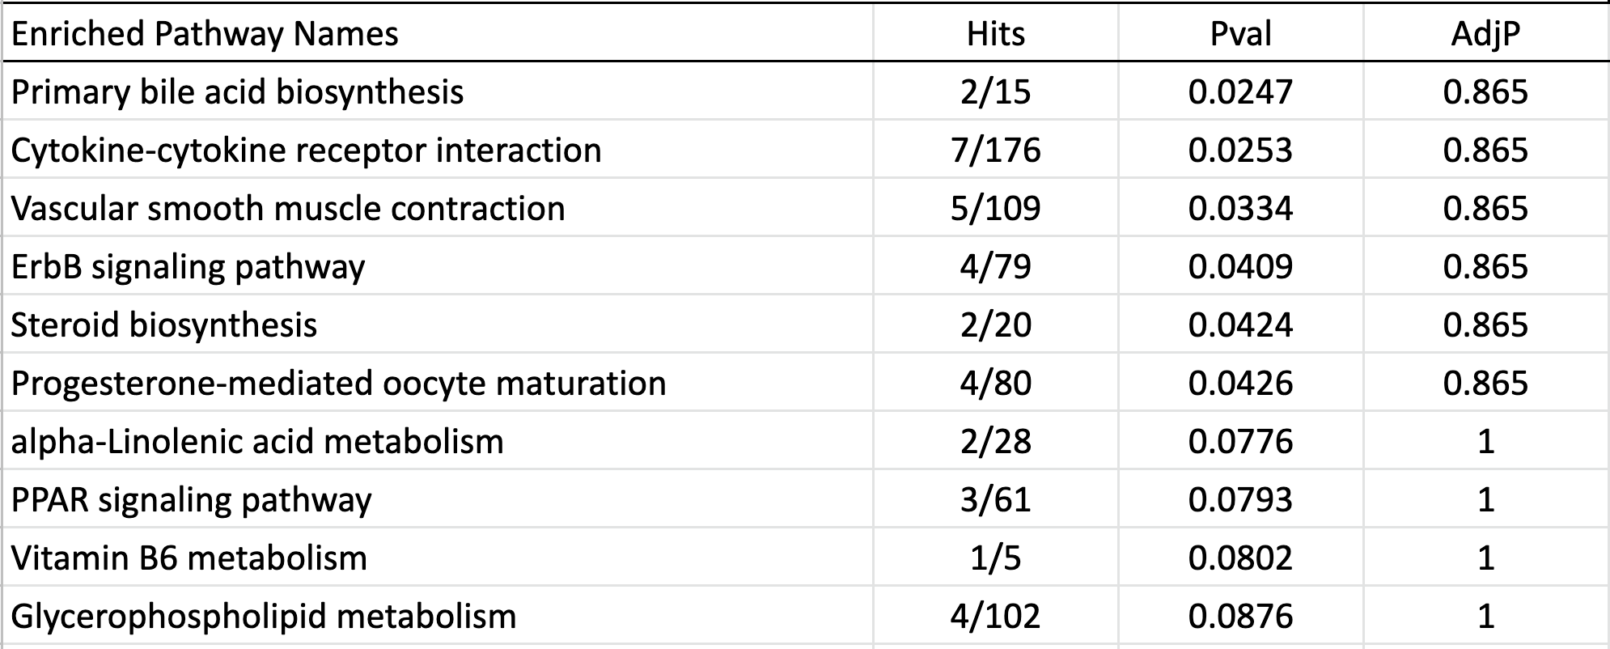
Answer1: dysregulated pathways in ELS
Categories of Representative DEGs:
Liver functions (e.g. cytochrome P450 2H2)
Egg yolk proteins formation (e.g. vitellogenin 1, 2)
Lipid metabolism (e.g. ELOVL fatty acid elongase 2)
Immune response (e.g. avidin-like)
Ion transportation (e.g. solute carrier family 5 member 5)
Pathway classifications:
Lipid metabolism
Endocrine system
Signaling transduction / molecules & interaction

Slide 19
Answer1: dysregulated pathways in ELS
Categories of Representative DEGs:
Liver functions (e.g. cytochrome P450 2H2)
Egg yolk proteins formation (e.g. vitellogenin 1, 2)
Lipid metabolism (e.g. ELOVL fatty acid elongase 2)
Immune response (e.g. avidin-like)
Ion transportation (e.g. solute carrier family 5 member 5)
Pathway classifications:
Lipid metabolism
Endocrine system
Signaling transduction / molecules & interaction

Slide 20
Answer1: dysregulated pathways in ELS
Categories of Representative DEGs:
Liver functions (e.g. cytochrome P450 2H2)
Egg yolk proteins formation (e.g. vitellogenin 1, 2)
Lipid metabolism (e.g. ELOVL fatty acid elongase 2)
Immune response (e.g. avidin-like)
Ion transportation (e.g. solute carrier family 5 member 5)
Pathway classifications:
Lipid metabolism
Endocrine system
Signaling transduction / molecules & interaction

Slide 21
Answer1: dysregulated pathways in ELS
Categories of Representative DEGs:
Liver functions (e.g. cytochrome P450 2H2)
Egg yolk proteins formation (e.g. vitellogenin 1, 2)
Lipid metabolism (e.g. ELOVL fatty acid elongase 2)
Immune response (e.g. avidin-like)
Ion transportation (e.g. solute carrier family 5 member 5)
Pathway classifications:
Lipid metabolism
Endocrine system
Signaling transduction / molecules & interaction

Slide 22
Background
Questions
Methods
Results
Discussion
Conclusion
Question 2:
What is the transcriptomic responses of adult Japanese quail to EE2?

Slide 23
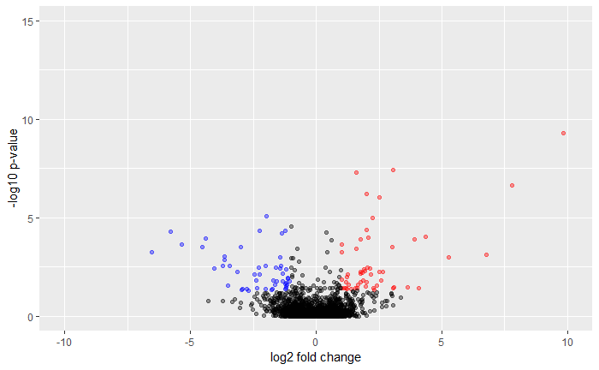
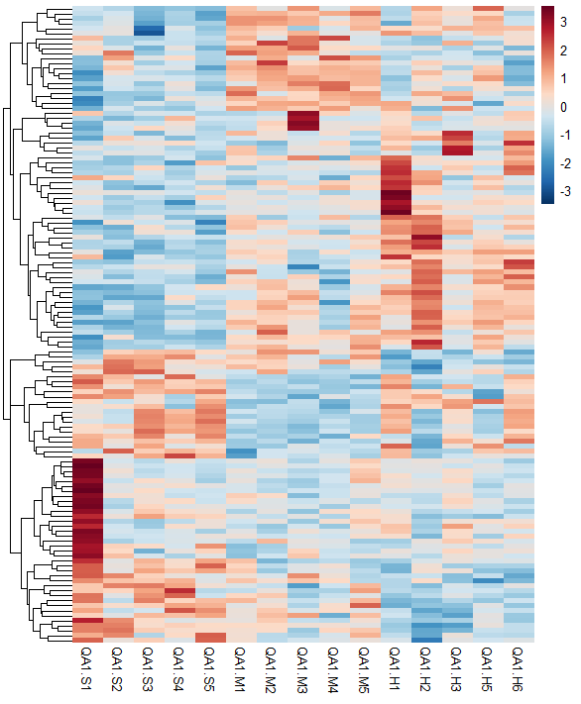
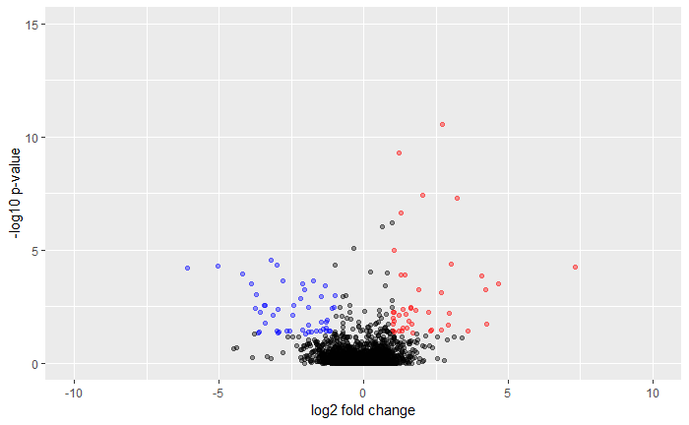
Answer 2: DEGs numbers in adult
Transcript counts
Control
EE2 med
EE2 high
Med vs control
High vs control
128 DEGs/12415 genes
↓ 59 DEGs ↑ 69 DEGs

Slide 24
a.
Transcript counts
b.
Med vs control
Med vs control
Control
EE2 med
EE2 high
High vs control
128 DEGs/12415 genes
↓ 59 DEGs ↑ 69 DEGs

Slide 25
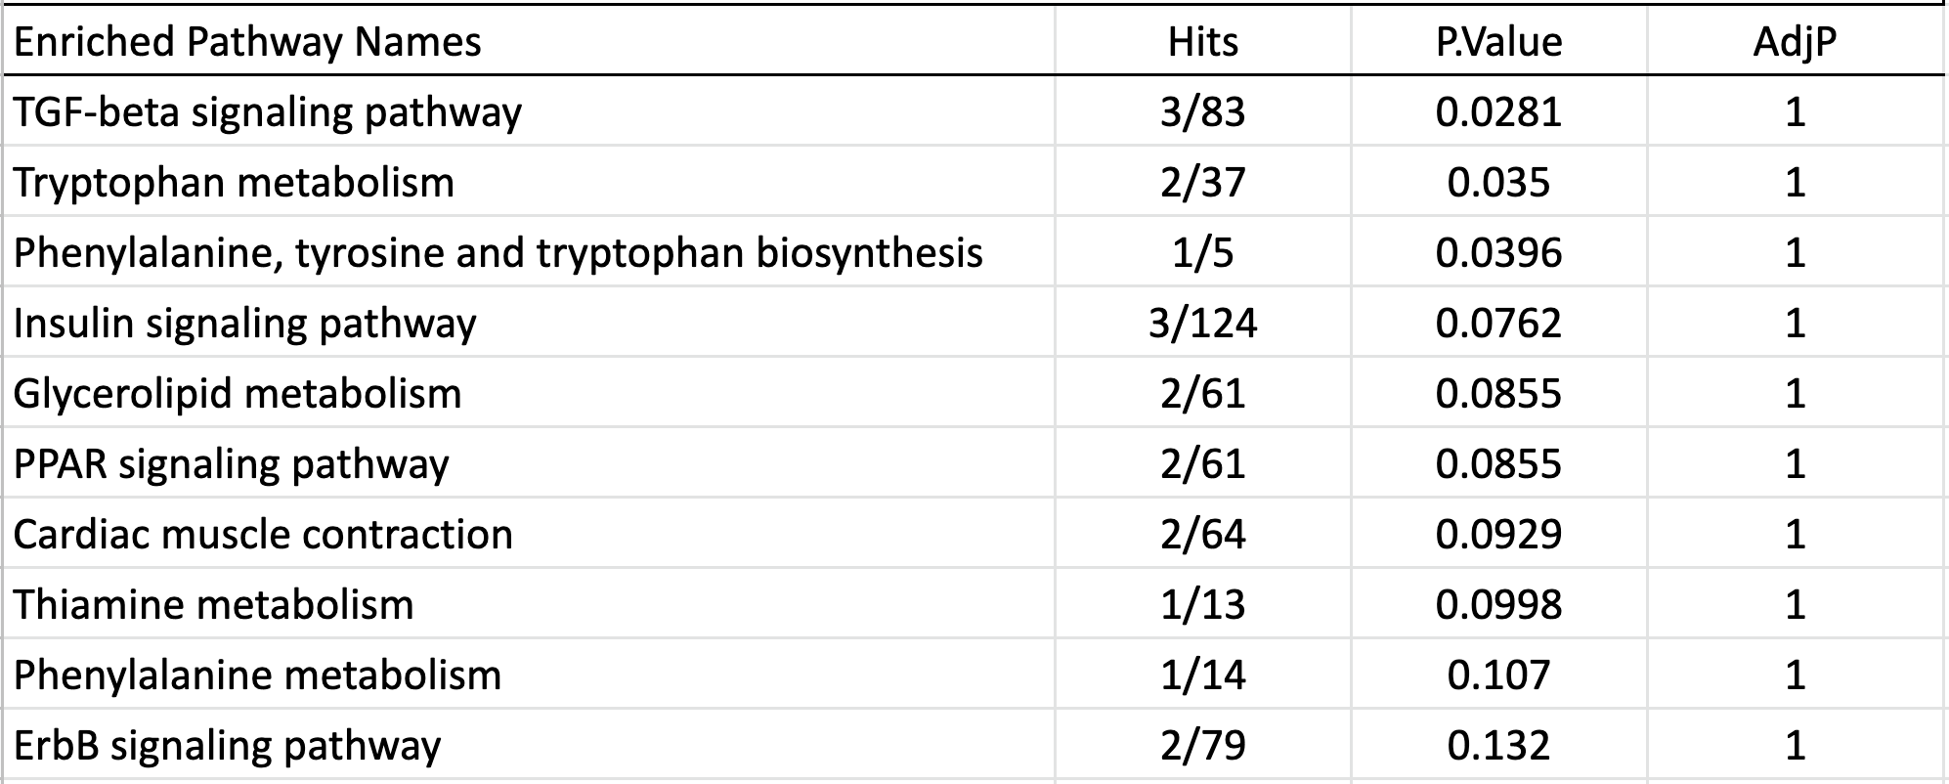
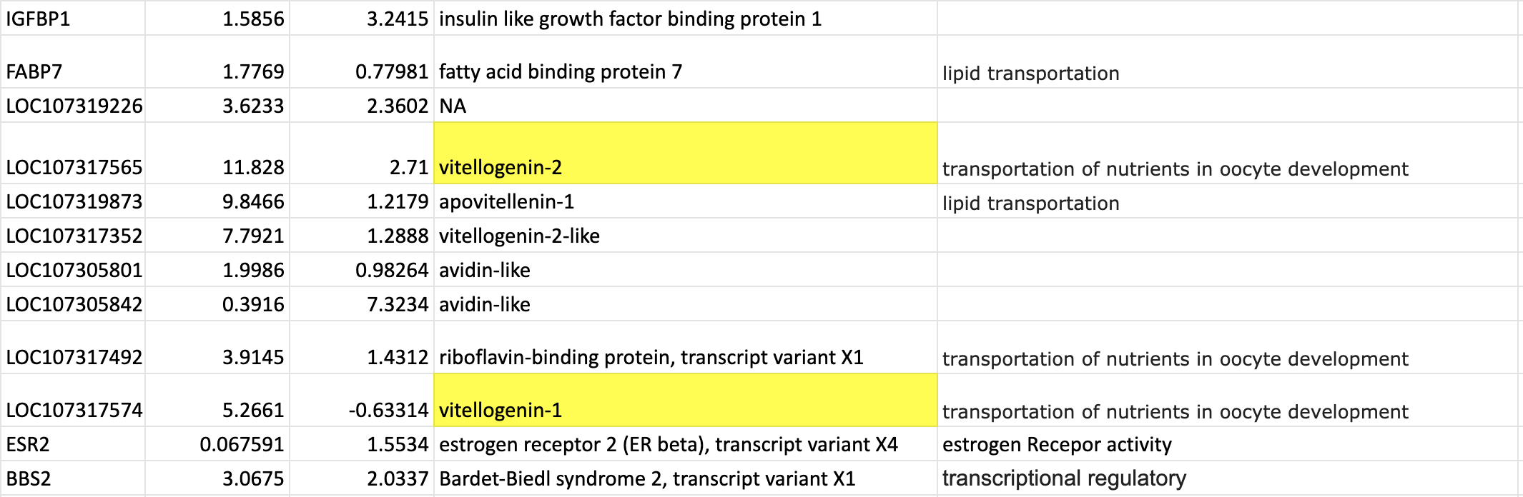
Answer1: dysregulated pathways in adult
Categories of Representative DEGs:
Lipid transportation (e.g. Apovitellenin-1)
Transportation of nutrients in oocyte development (e.g.Vitellogenin-1, riboflavin-binding protein)
Estrogen Receptor activity (e.g. estrogen receptor 2 beta)
Transcriptional regulation (e.g. Bardet-Biedl syndrome 2)
Pathway classifications:
Amino acids metabolism
Endocrine system
Signaling transduction

Slide 26
Answer1: dysregulated pathways in adult
Categories of Representative DEGs:
Lipid transportation (e.g. Apovitellenin-1)
Transportation of nutrients in oocyte development (e.g.Vitellogenin-1, riboflavin-binding protein)
Estrogen Receptor activity (e.g. estrogen receptor 2 beta)
Transcriptional regulation (e.g. Bardet-Biedl syndrome 2)
Pathway classifications:
Amino acids metabolism
Endocrine system
Signaling transduction

Slide 27
Answer1: dysregulated pathways in adult
Categories of Representative DEGs:
Lipid transportation (e.g. Apovitellenin-1)
Transportation of nutrients in oocyte development (e.g.Vitellogenin-1, riboflavin-binding protein)
Estrogen Receptor activity (e.g. estrogen receptor 2 beta)
Transcriptional regulation (e.g. Bardet-Biedl syndrome 2)
Pathway classifications:
Amino acids metabolism
Endocrine system
Signaling transduction

Slide 28
Answer1: dysregulated pathways in adult
Categories of Representative DEGs:
Lipid transportation (e.g. Apovitellenin-1)
Transportation of nutrients in oocyte development (e.g.Vitellogenin-1, riboflavin-binding protein)
Estrogen Receptor activity (e.g. estrogen receptor 2 beta)
Transcriptional regulation (e.g. Bardet-Biedl syndrome 2)
Pathway classifications:
Amino acids metabolism
Endocrine system
Signaling transduction

Slide 29
Comparison of ELS and Adult
Background
Questions
Methods
Results
Discussion
Conclusion
Determine patterns
Overlapping DEGs & pathways
Biological meaning

Slide 30
1. The transcript counts of hepatic genes in ELS & adult JQ
ELS
Adult
Control
EE2 med
EE2 high
Control
EE2 med
EE2 high
Transcript counts
Transcript counts

Slide 31
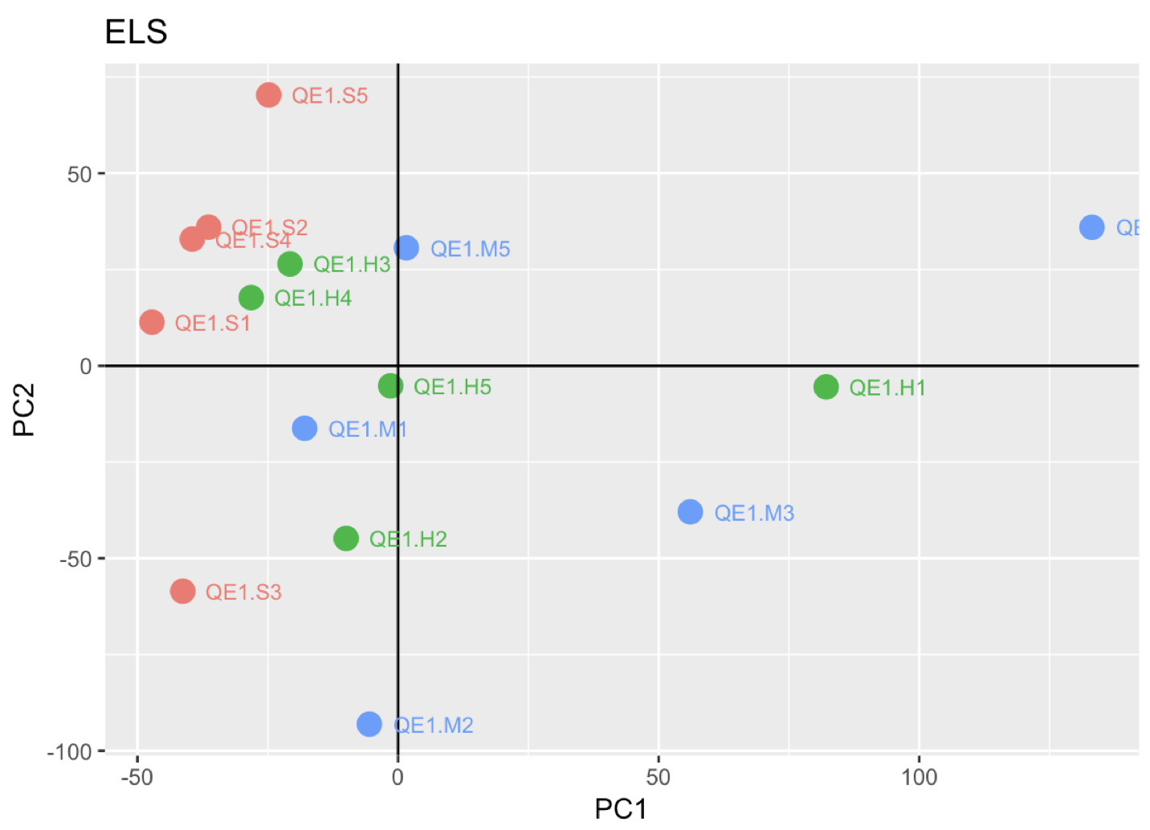
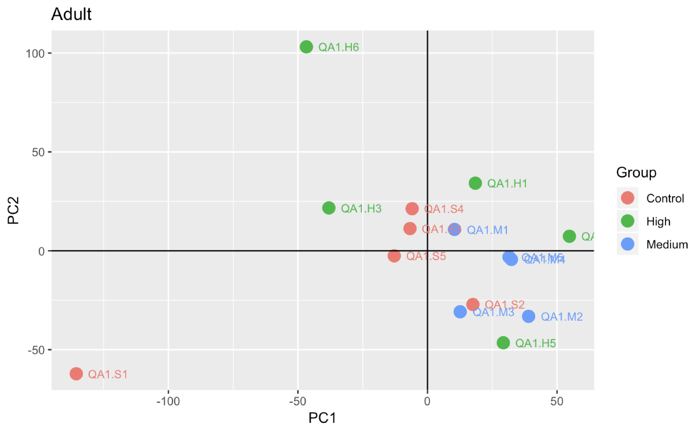
PCA plots

Slide 32
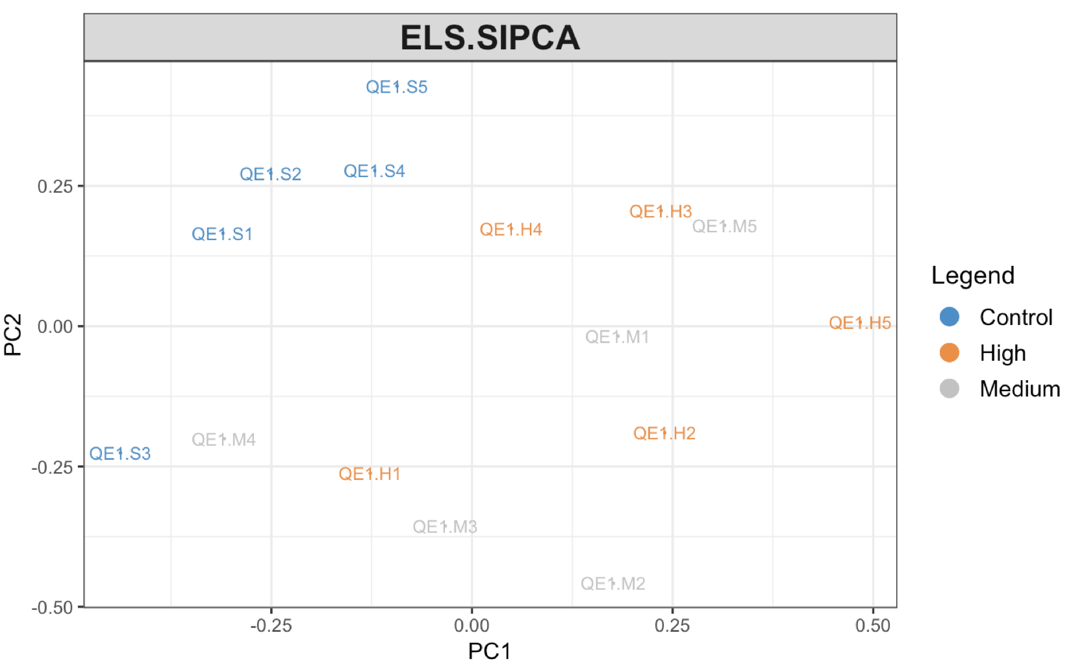
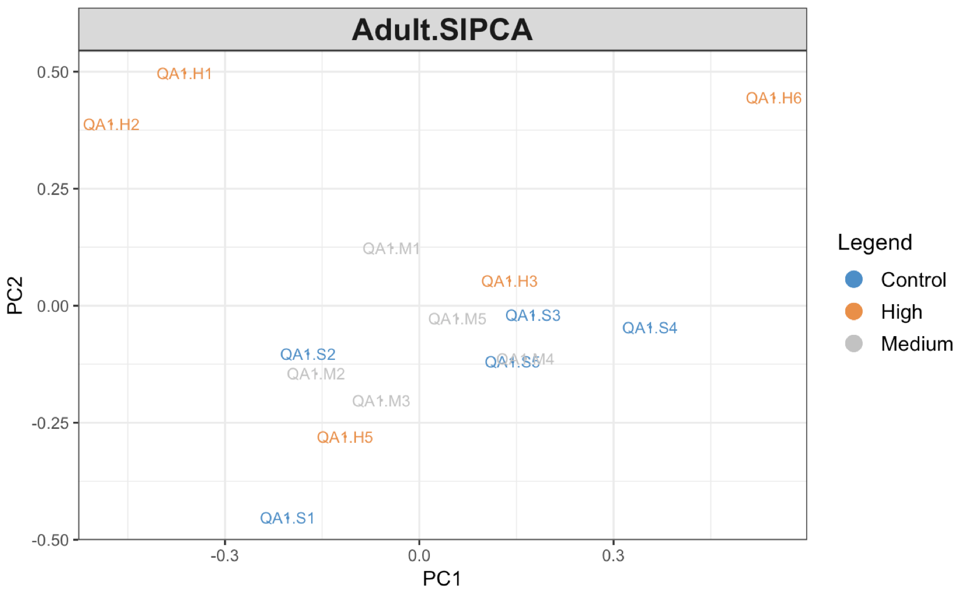
sIPCA plots

Slide 33
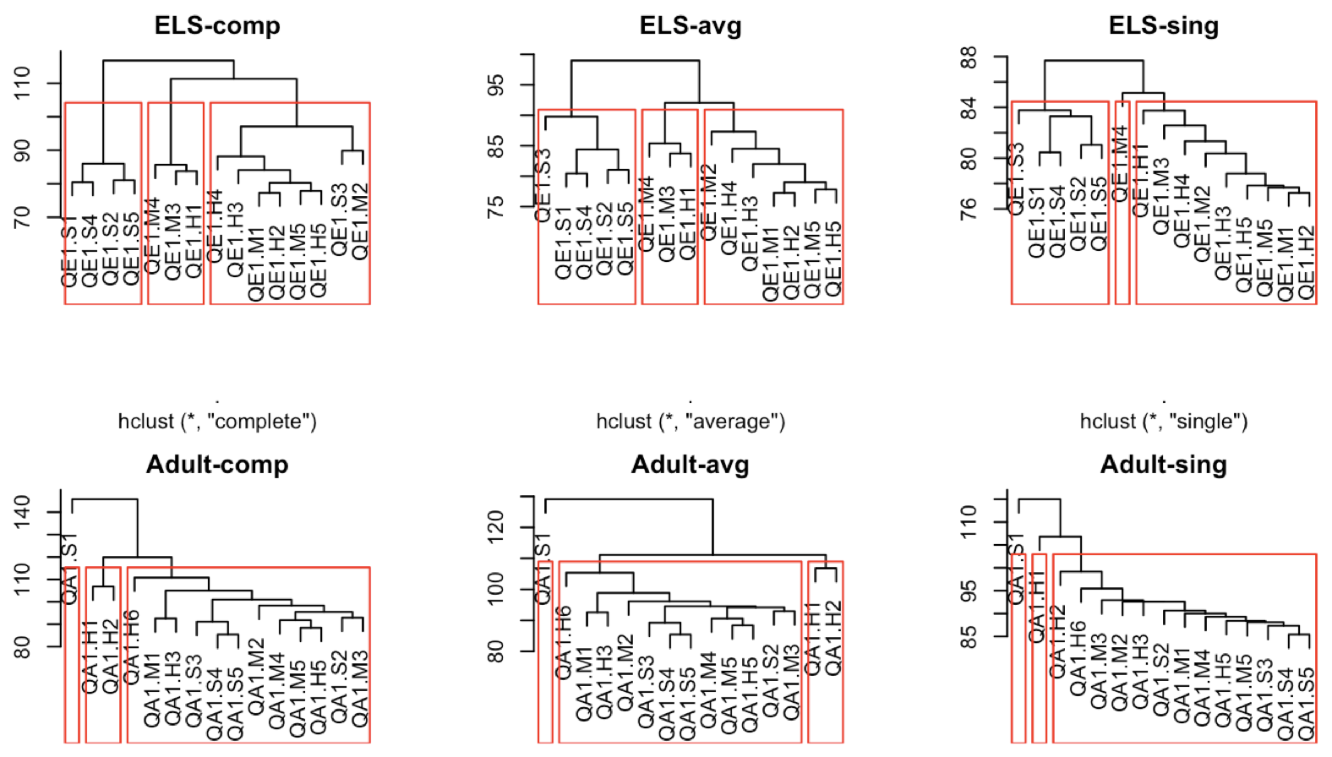
Hierarchical cluster plots
: Control

Slide 34
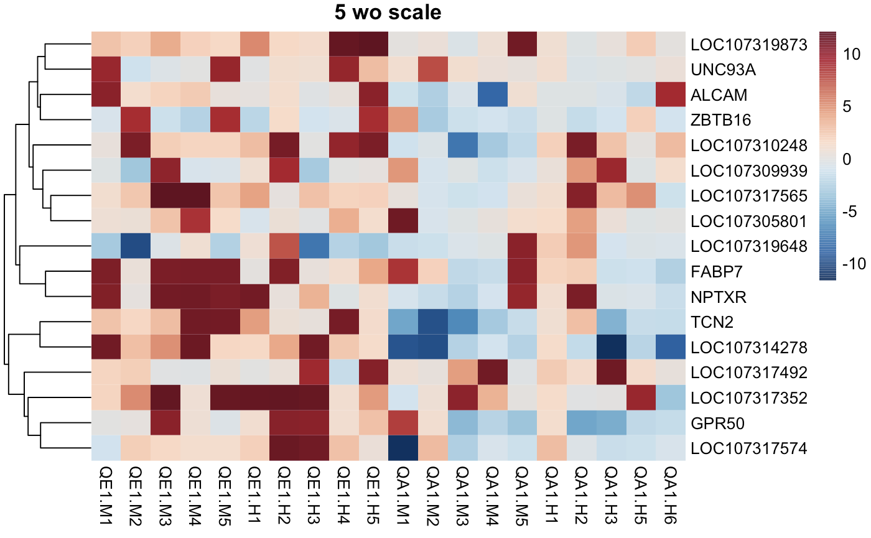
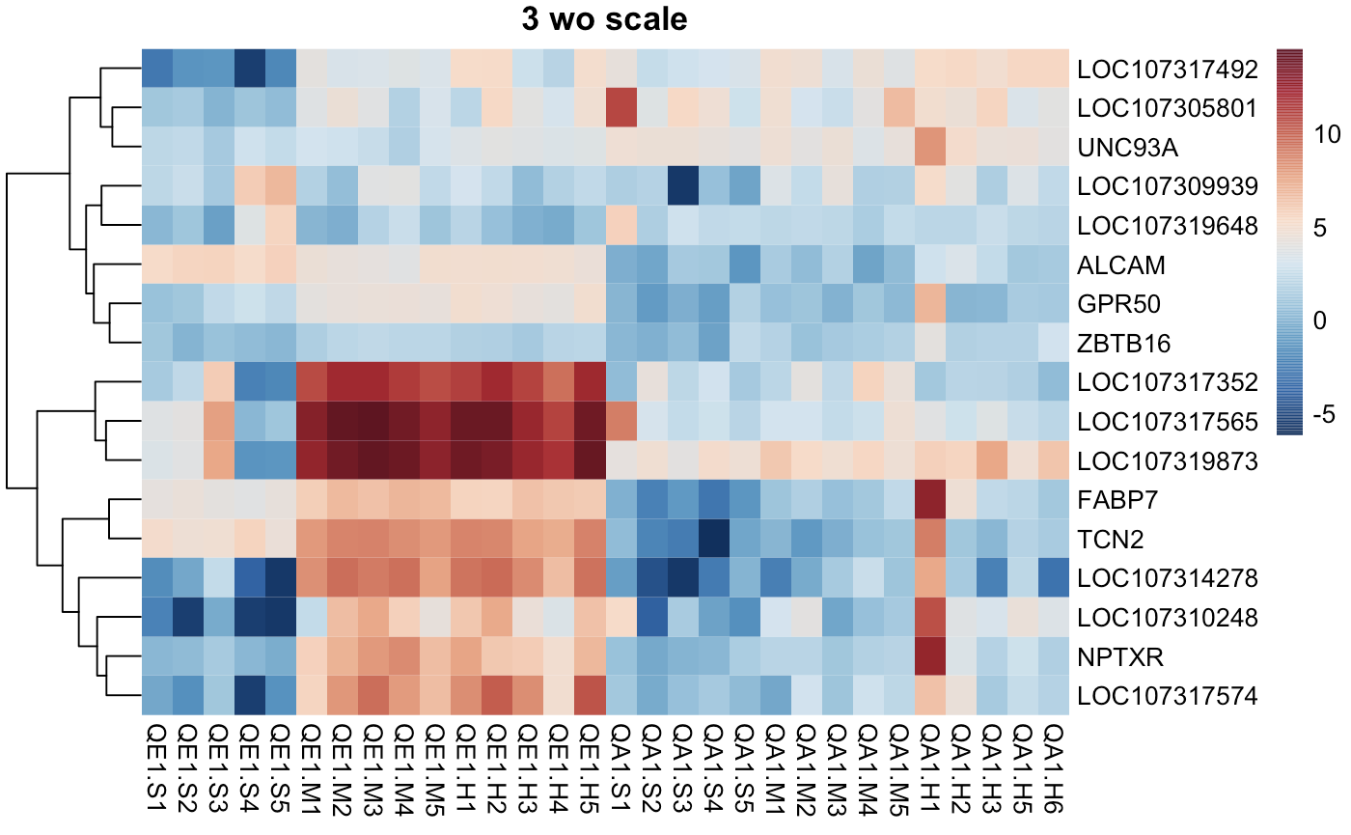
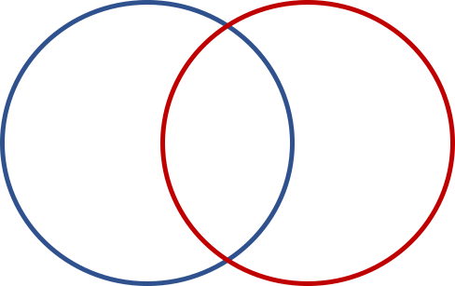
2. Overlapping DEGs’ log₂FC
ELS Adult
ELS
med vs con high vs con
Adult
med vs con high vs con
Control
EE2
med high
Control
EE2
med high
ELS Adult
229 17 111
Transcript counts
Log₂ FC

Slide 35
Dysregulation direction
ELS
med vs con high vs con
Adult
med vs con high vs con
Log₂ FC

Slide 36
2. Overlapping DEGs’ log₂FC
Parameters | Correlation
logFC (High vs Control) | 0.855 *
logFC (Medium vs Control) | 0.617 *
logCPM | 0.615 *
LR | -0.237
p-value | -0.139
adjusted p-value | -0.134
→ Association between the logFC values of ELS and adult

Slide 37
3. Biological meaning of DEGs
ELS Adult
Interesting DEGs in ELS
Liver functions (e.g. cytochrome P450 2H2)
Egg yolk proteins formation (e.g. vitellogenin 1, 2)
Lipid metabolism (e.g. ELOVL fatty acid elongase 2)
Immune response (e.g. avidin-like)
Ion transportation (e.g. solute carrier family 5 member 5)
229 17 111

Slide 38
3. Biological meaning of DEGs
ELS Adult
Interesting DEGs in adult
Lipid transportation (e.g. apovitellenin-1)
Transportation of nutrients in oocyte development (e.g. vitellogenin-1, riboflavin-binding protein)
Estrogen Receptor activity (e.g. estrogen receptor 2 beta)
Transcriptional regulation (e.g. Bardet-Biedl syndrome 2)
229 17 111

Slide 39
3. Overlapping DEGs’ biological functions
ELS Adult
Interesting DEGs in common
Growth (e.g. vitellogenin-2-like, apovitellenin-1, riboflavin-binding protein)
Immune response (e.g. avidin-like, interferon alpha-inducible protein 6-like)
229 17 111

Slide 40
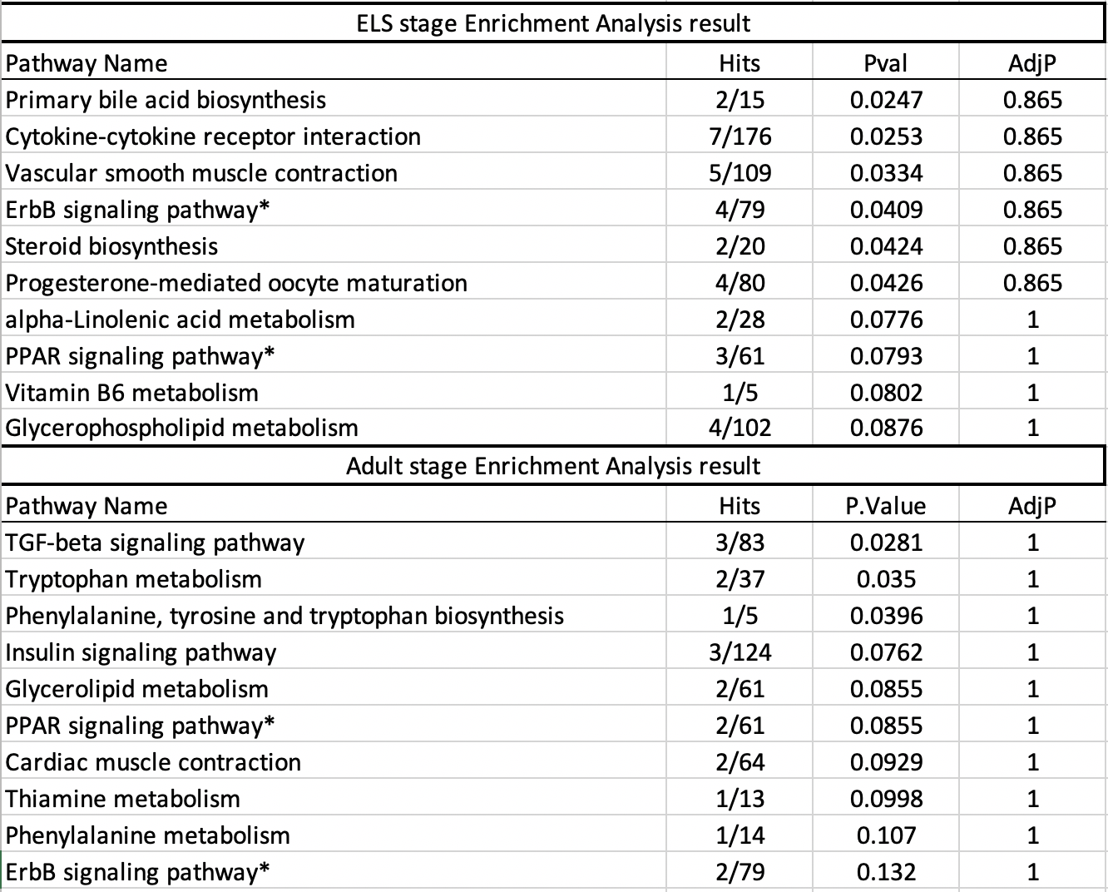
4. Enriched pathways
ELS Adult
229 17 111

Slide 41
4. Enriched pathways
Functionally related to...
Circulatory system
Endocrine system
Lipid metabolism
Metabolism of cofactors and vitamins
Amino acid metabolism
Signal transduction

Slide 42
4. Enriched pathways
Functionally relate to...
Circulatory system
Endocrine system
Lipid metabolism
Metabolism of cofactors and vitamins
Amino acid metabolism
Signal transduction
LOC107311343 (CYP1B1)
IL4I1

Slide 43
5. Overlapping enriched pathways
ELS Adult
229 17 111

Slide 44
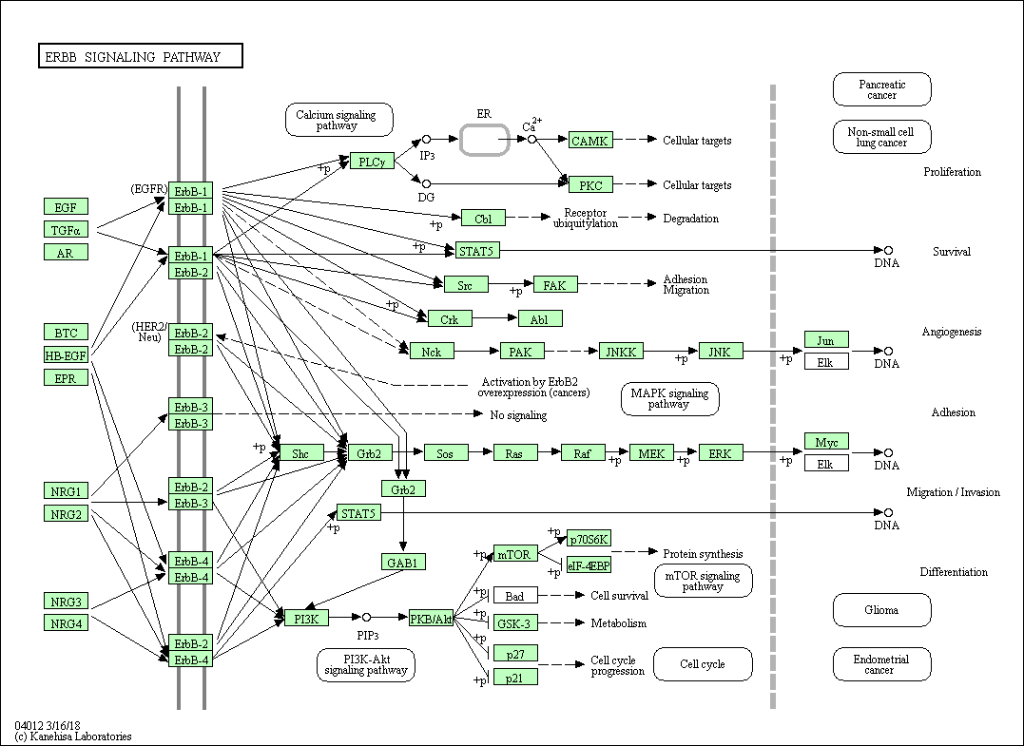
ErbB signalling pathway
Gene hit by ELS
Gene hit by Adult
Presence of genes

Slide 45
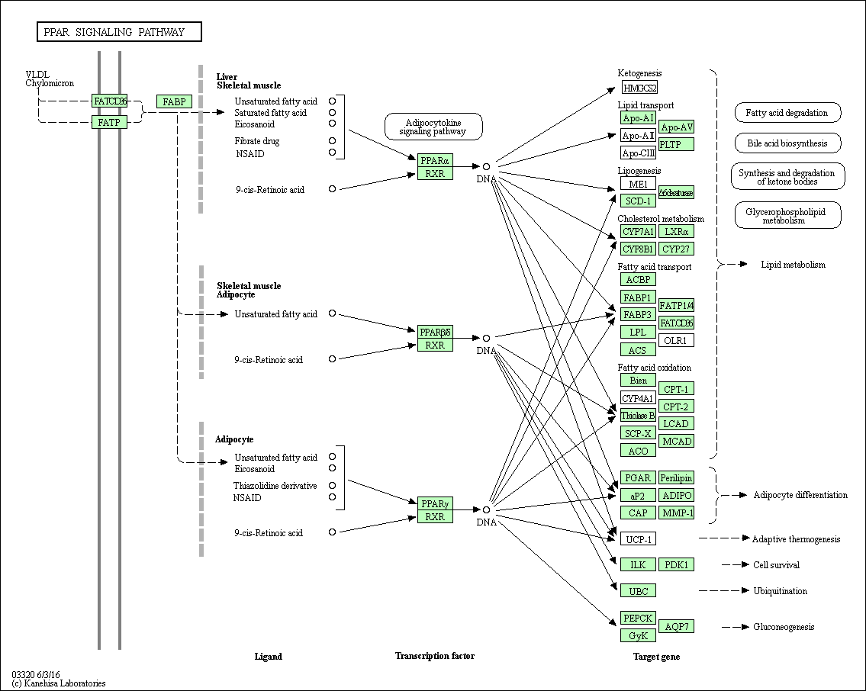
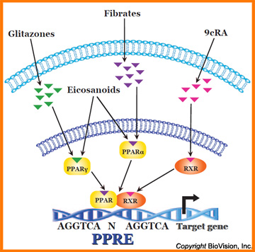
PPAR signalling pathway
abs(LogFC): ELS > Adult
Gene hit by ELS
Gene hit by Adult
Presence of genes

Slide 46
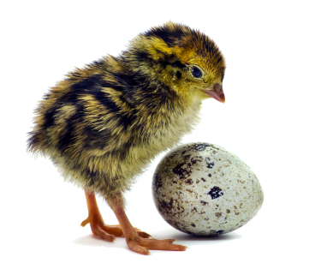
Conclusion
Background
Questions
Methods
Results
Discussion
Conclusion
Upon the exposure to EE2,
DEG #s: ELS (246) > adult (128)
Degree of dysregulation: ELS > adult
DEG hit #s for dysregulated pathways: ELS > adult
Upstream genes’ #s and FC: ELS > adult
→ ELS is more susceptible in response to EE2 than adult

Slide 47
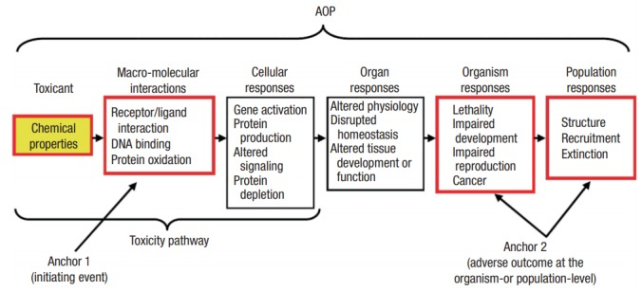

Limitations & future directions
Wild vs lab JQ
→ Capture & study wild JQ directly
Lack of dose-response curve
→ Conduct dose-response modelling
Limited JQ gene function & pathway data available
→ qPCR to validate true DEGs
→ Develop adverse outcome pathway

Slide 48


Slide 49
References
Chen, Y., Li, M., Yuan, L., Xie, Y., Li, B., Xu, W., …, and Wang, R. (2017). Growth, blood health, antioxidant status and immune response in juvenile yellow catfish Pelteobagrus fulvidraco exposed to α-ethinylestradiol (EE2). Fish & shellfish immunology, 69, 1-5.
Mohammed, A. (2013). Why are early life stages of aquatic organisms more sensitive to toxicants than adults? New insights into toxicity and drug testing: InTech.
Pokharel, A., Kola, S., Matouskova K., and Vandenberg LN. (2018). Asymmetric development of the male mouse mammary gland and its response to a prenatal or postnatal estrogen challenge. Reproductive Toxicology Elsevier, Vol. 82, pg 63-71.
Vosges, M., Braguer, J., Combarnous, Y. (2008). Long-term exposure of male rats to low-dose ethinylestradiol (EE2) in drinking water: Effects on ponderal growth and on litter size of their progeny. Reproductive Toxicology Elsevier, Vol. 25, pg 161-168.

Slide 50
Questions
The difference among enrichment pathway analysis,
The difference between ORA and GSEA and the limitation of ORA
What’s ORA? ORA takes into account the number of differentially expressed genes observed in a pathway as indicators of pathway states; generally, it uses a basic contingency table to test the association between the differential expression status of a gene (e.g., differentially expressed gene, or not) and its membership in a given gene set (e.g., pathway gene, or not), which can be measured by the P-value of a hypergeometric test.
Why we use PCA, sIPCA, and clusters again?
What is the difference between PCA and sIPCA?
Can we really compare ELS and adult and get the conclusion of likely susceptibility?

